Slide 1

CAPSTONE PROJECT
TITLE:BANK MARKETING
BATCH:(WS103117)
NAME:WANIA ZEHRA RAHMAT

Slide 2
PROBLEM STATEMENT AND
DATA SOURCES
Sources:
Created by: Paulo Cortez (Univ. Minho) and Sérgio Moro (ISCTE-IUL) @ 2012
Past Usage:
The full dataset was described and analysed in:
S. Moro, R. Laureano and P. Cortez. Using Data Mining for Bank Direct Marketing: An Application of the CRISP-DM Methodology.
In P. Novais et al. (Eds.), Proceedings of the European Simulation and Modelling Conference - ESM'2011, pp. 117-121, Guimarães,
Portugal, October, 2011. EUROSIS.
Relevant Information:
The data is related with direct marketing campaigns of a Portuguese banking institution.
The marketing campaigns were based on phone calls. Often, more than one contact to the same client was required.

Slide 3
In order to access if the product (bank term deposit) would be (or not) subscribed.
The classification goal is to predict if the client will subscribe a term deposit (variable y).
Number of Attributes: 16 + output attribute.

Slide 4
GENERAL INFO ABOUT DATA
Input variables:
1 - age (numeric)
2 - job : type of job (categorical:"admin.","unknown","unemployed","management","housemaid","entrepreneur","student","blue-collar","self-employed","retired","technician","services")
3 - marital : marital status (categorical: "married","divorced","single"; note: "divorced" means divorced or widowed)
4 - education (categorical: "unknown","secondary","primary","tertiary")
5 - default: has credit in default? (binary: "yes","no")
6 - balance: average yearly balance, in euros (numeric)
7 - housing: has housing loan? (binary: "yes","no")
8 - loan: has personal loan? (binary: "yes","no")
# related with the last contact of the current campaign:
9 - contact: contact communication type (categorical: "unknown","telephone","cellular")
10 - day: last contact day of the month (numeric)
11 - month: last contact month of year (categorical: "Jan", "feb", "mar", ..., "nov", "dec")
12 - duration: last contact duration, in seconds (numeric)

Slide 5
other attributes:
13 - campaign: number of contacts performed during this campaign and for this client (numeric, includes last contact)
14 - pdays: number of days that passed by after the client was last contacted from a previous campaign (numeric, -1 means client was not previously contacted)
15 - previous: number of contacts performed before this campaign and for this client (numeric)
16 - poutcome: outcome of the previous marketing campaign (categorical: "unknown","other","failure","success")
Output variable (desired target):
17 - y - has the client subscribed a term deposit? (binary: "yes","no")

Slide 6
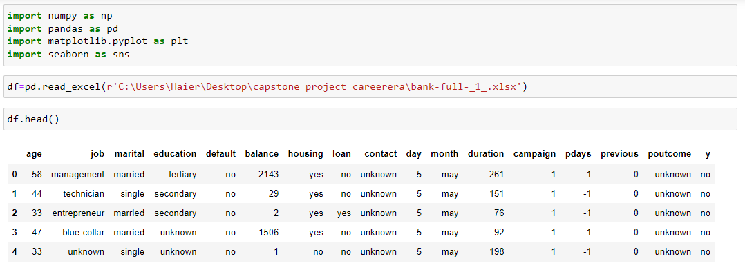
Solution approach
DATA COLLECTION:

Slide 7
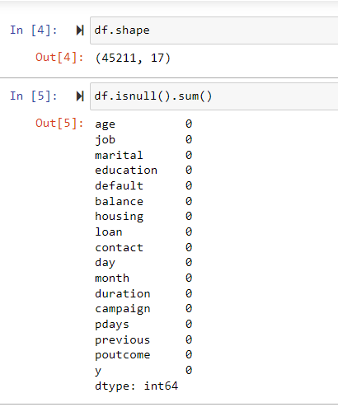
CLEAN THE DATA:

Slide 8
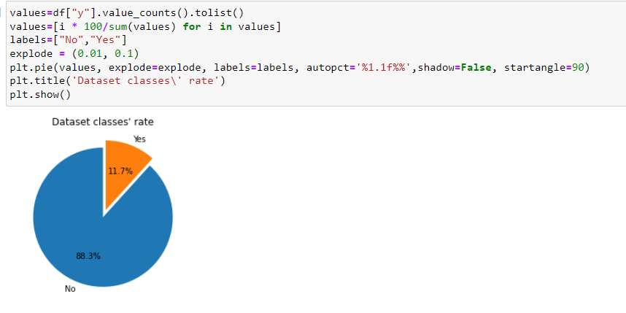
HANDLING IMBALANCE DATASET:

Slide 9
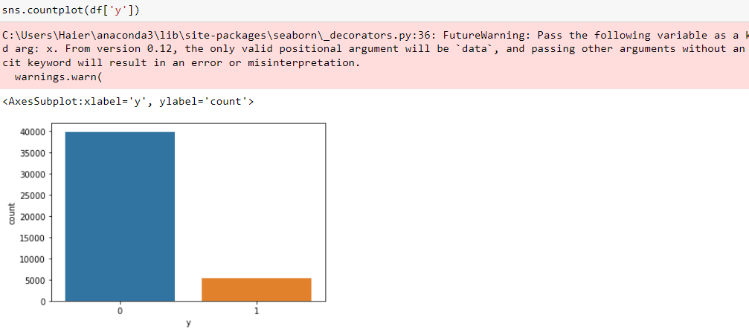
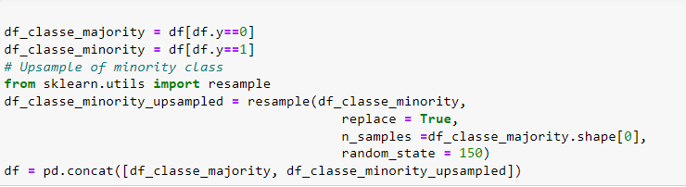

Slide 10
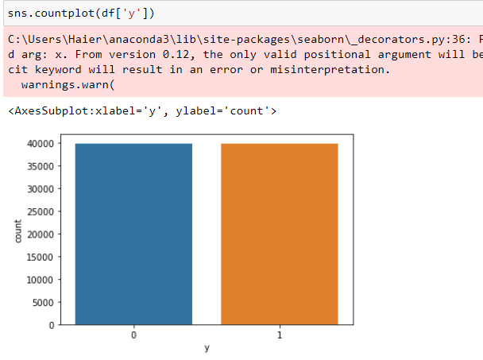

Slide 11
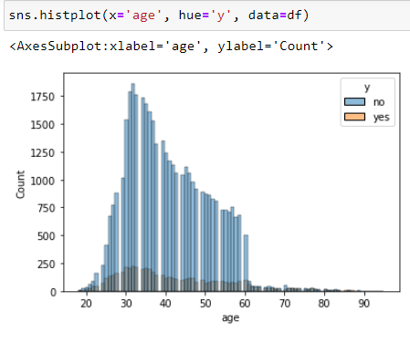
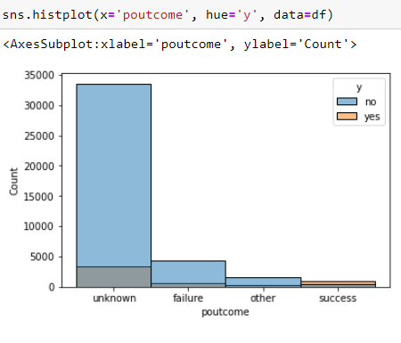
EDA ON DATA
DATA VISUALIZATION:

Slide 12
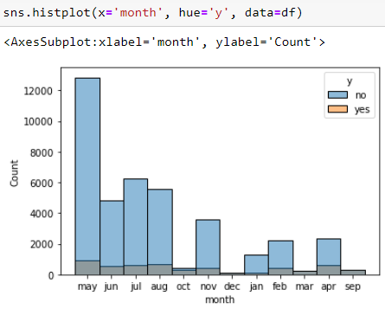
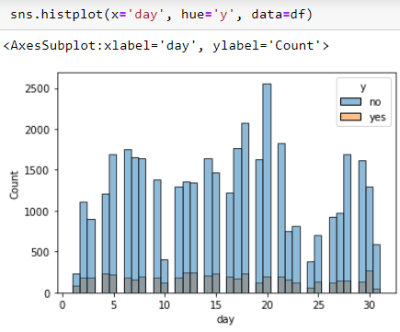
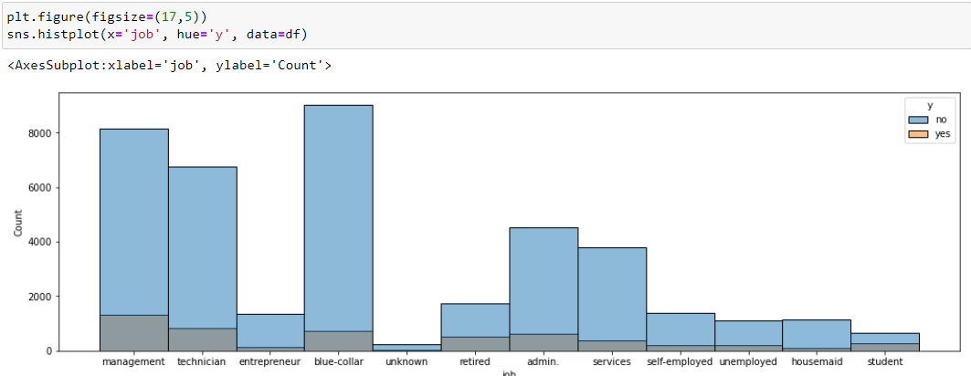

Slide 13
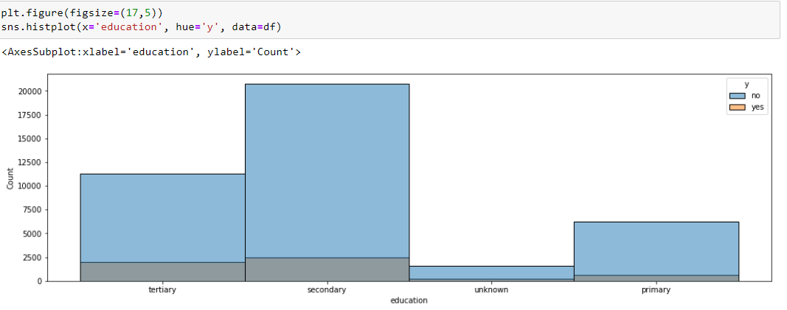
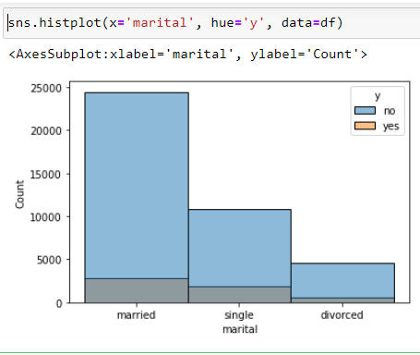
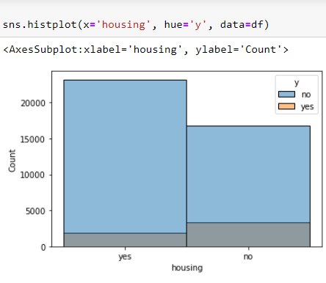

Slide 14
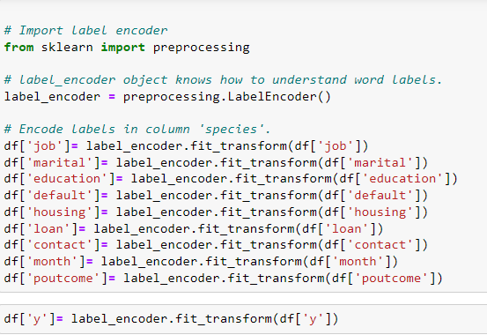
DATA ENCODING:
Converting categorical values to numeric

Slide 15
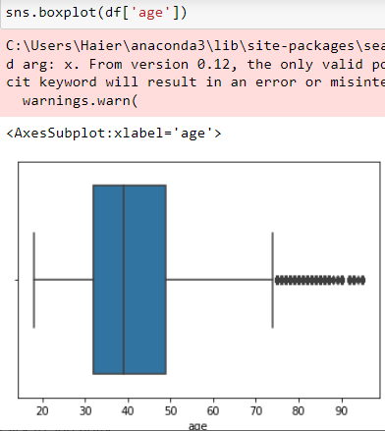
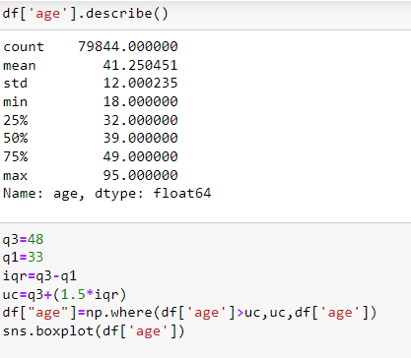
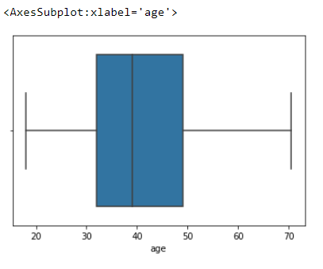
TREATING OUTLIERS:

Slide 16
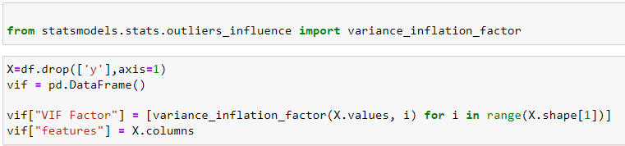
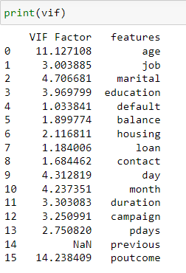
FEATURE SELECTION:
Deleting the columns with vif greater than 10

Slide 17
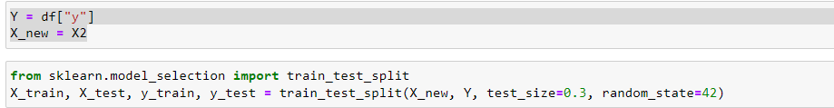
DATA SPLITTING

Slide 18
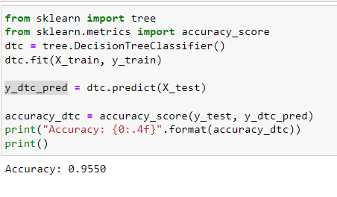
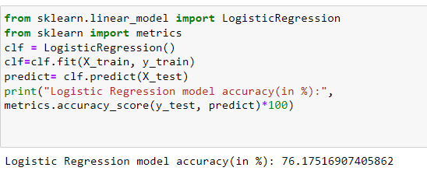
MODEL IMPLEMENTATION

Slide 19
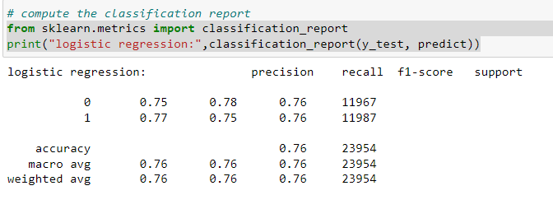
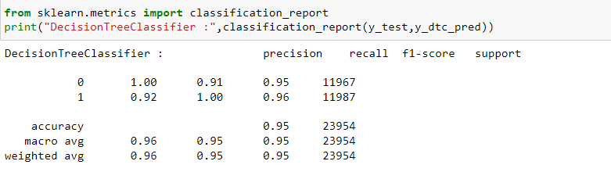
CLASSIFICATION REPORT:

Slide 20
THANKS

